Slide 1


JAVA INTERVIEW BOOTCAMP CORE CONCEPTS
Lecture 20
Strings

Slide 2
CHAPTER 20
Strings
Topics Covered
The String class
The StringBuffer class
The StringBuilder class

Slide 3
What Is A String ?
In Java, a string is defined as a sequence of characters.
But, unlike many other languages that implement strings as character arrays, java implements strings as objects of type String.

Slide 4
How To Represent Strings In Java ?
Java handles Strings by three classes:
String
StringBuffer and
StringBuilder
All are defined in the package java.lang and and most interviews cover only String and StringBuffer classes

Slide 5
String V/s StringBuffer V/s StringBuilder
String | StringBuffer | StringBuilder
Added from JDK 1.0 | Added from JDK 1.0 | Added from JDK 5.0
String objects are immutable | StringBuffer objects are mutable | StringBuilder objects are mutable
String objects are stored in heap and string constants are stored in “String Pool” | StringBuffer objects are stored in heap | StringBuilder objects are stored in heap
Thread-Safe | Thread-Safe | Not Thread-Safe
Fast performance | Very slow performance | Fast performance

Slide 6
Important Facts About “String”
String is probably the most commonly used class in java library.
String class is encapsulated under java.lang package.
In java, every string that you create is actually an object of type String.
One important thing to notice about string object is that string objects are immutable

Slide 7
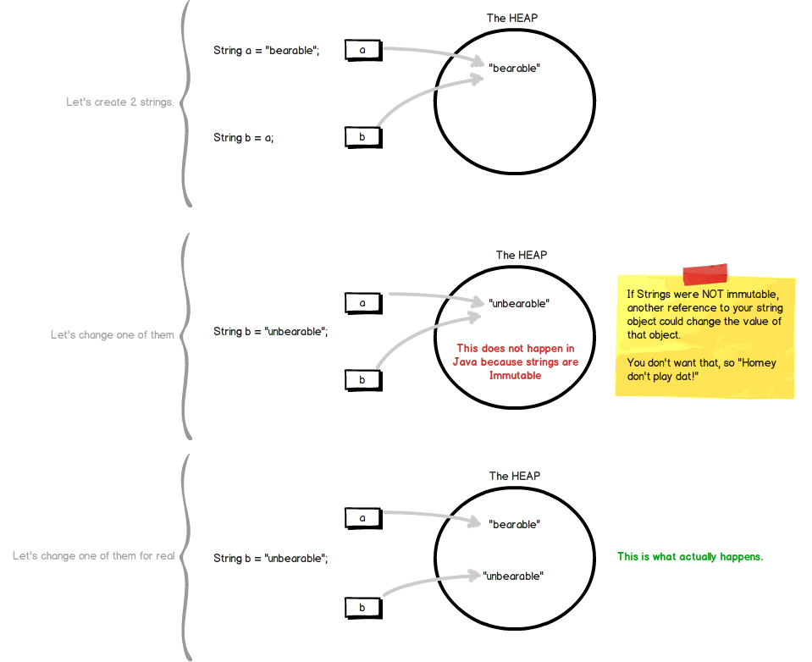
What Is An Immutable Object ?

Slide 8
Creating “String” Object
Java provides 2 ways to create “String” objects
Using “String Literal”
Using new keyword

Slide 9
String Literals…
are anonymous objects of the String class
are defined by enclosing text in double quotes. “Bhopal”
can be passed to methods and constructors as parameters.
have methods we can call.

Slide 10
String Literal Examples
//assign a literal to a String variable
String name = “Sachin”;
//calling a method on a literal String
int len = “Sachin”.length( );

Slide 11
Using The new Keyword
Using the new operator creates a memory location on the heap.
Example:
String name=new String(“Sachin”);
name
“Sachin”

Slide 12
What Is The Difference ?
String literals reside in a special area of memory called “String Constant Pool” while string objects live in heap.
When the compiler encounters a String literal, it checks the pool to see if an identical String already exists.
If a match is found, the reference to the new literal is directed to the existing String, and no new String literal object is created. (The existing String simply has an additional reference.)

Slide 13
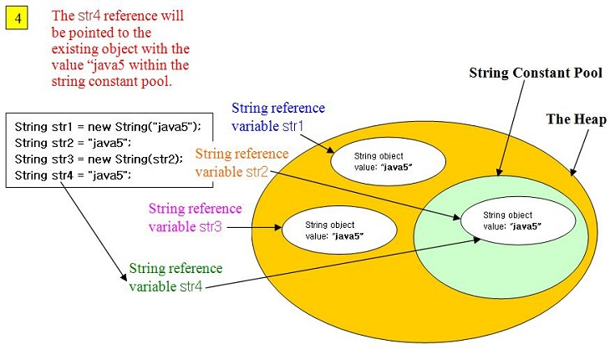
What Is The Difference ?

Slide 14
Empty Strings
An empty String has no characters. It’s length is 0.
Not the same as an uninitialized String.
String word1 = "";
String word2 = new String();
Empty strings
private String name;
name is null

Slide 15
No Argument Constructors
No-argument constructor creates an empty String.
A more common approach is to assign the variable to an empty literal String.
String empty = new String();
String empty = “”;//nothing between quotes

Slide 16
Copy Constructors
Copy constructor creates a copy of an existing String.
Not the same as an assignment.
Copy Constructor: Each variable points to a different copy of the String.
String word = new String(“Java”); String word2 = new String(word);
word
“Java"
word2
“Java"
Assignment: Both variables point to the same String.
String word = “Java”; String word2 = word;
word
“Java"
word2
String word3= “Java”;
word3

Slide 17
Other Constructors
Most other constructors take an array as a parameter
to create a String.
char[] letters = {‘J’, ‘a’, ‘v’, ‘a’}; String word = new String(letters);//”Java”

Slide 18
Methods — length, charAt
int length();
char charAt(int i);
Returns the number of characters in the string
Returns the char at position i.
Character positions in strings are numbered starting from 0 – just like arrays.
Returns:
”Problem”.length();
”Window”.charAt (2);
7
’n'

Slide 19
What Is The Output ?
String x=“test”;
System.out.println(x.length);
String [ ] months=new String[12];
System.out.println(months.length());
Both codes will produce syntax error!

Slide 20
Why ?
Arrays have an attribute (not a method) called length, while String objects have a method called length() ( not an attribute)
So an attempt to use the length() method on an array or an attempt to use the length attribute on a String, both cause compiler error

Slide 21
Methods — substring
Returns a new String by copying characters from an existing String.
String subs = word.substring (i, k);
returns the substring of chars in positions from i to k-1
String subs = word.substring (i);
returns the substring from the i-th char to the end
television
i k
television
i
Returns:
”television”.substring (2,5);
“immutable”.substring (2);
“hello”.substring (5);
“lev”
“mutable”
"" (empty string)

Slide 22
Methods — Find (indexOf)
0 2 6 10 15
String name =“President George Washington";
name.indexOf (‘P'); 0
name.indexOf (‘e'); 2
name.indexOf (“George"); 10
name.indexOf (‘e', 3); 6 6
name.indexOf (“Bill"); -1
name.lastIndexOf (‘e'); 15
Returns:
(starts searching at position 3)
(not found)
Notes:
String has four overloaded versions of indexOf and four versions of lastIndexOf.
lastIndexOf(ch, fromPos) starts looking at fromPos and goes backward towards the beginning of the string.

Slide 23
Methods — Concatenation
String word1 = “re”, word2 = “think”; word3 = “ing”;
int num = 2;
String result = word1 + word2;
//concatenates word1 and word2 “rethink“
String result = word1.concat (word2);
//the same as word1 + word2 “rethink“
result += word3;
//concatenates word3 to result “rethinking”
result += num;
//converts num to String and concatenates it to result “rethinking2”

Slide 24
Methods — Equality
boolean equals(Object)
returns true if the string word1 is equal to word2
boolean equalsIgnoreCase(String)
returns true if the string word1 matches word2, case-blind
b = “Bhopal”.equals(“Bhopal”);//true
b = “Bhopal”.equals(“bhopal”);//false b = “Bhopal”.equalsIgnoreCase(“bhopal”);//true
Notes:
You cannot use relational operators for comparing the contents of strings.
word1.compareTo(word2) returns an int. Basically if word1 is “smaller” than word2, the result is negative, and if word1 is “larger” the result is positive. compareTo returns 0 whenever equals returns true.
Here is how Java docs describe compareTo:
Compares two strings lexicographically. The comparison is based on the Unicode value of each character in the strings. The character sequence represented by this String object is compared lexicographically to the character sequence represented by the argument string. The result is a negative integer if this String object lexicographically precedes the argument string. The result is a positive integer if this String object lexicographically follows the argument string. The result is zero if the strings are equal; compareTo returns 0 exactly when the equals(Object) method would return true.
This is the definition of lexicographic ordering. If two strings are different, then either they have different characters at some index that is a valid index for both strings, or their lengths are different, or both. If they have different characters at one or more index positions, let k be the smallest such index; then the string whose character at position k has the smaller value, as determined by using the < operator, lexicographically precedes the other string. In this case, compareTo returns the difference of the two character values at position k in the two string — that is, the value:
this.charAt(k)-anotherString.charAt(k)
If there is no index position at which they differ, then the shorter string lexicographically precedes the longer string. In this case, compareTo returns the difference of the lengths of the strings — that is, the value:
this.length()-anotherString.length()

Slide 25
Methods — Comparisons
int compareTo(Object)
String s1=“Bhopal”;
String s2=“bhopal”;
int ans=s1.compareTo(s2);
System.out.println(ans);
//Will print -32
Notes:
You cannot use relational operators for comparing the contents of strings.
word1.compareTo(word2) returns an int. Basically if word1 is “smaller” than word2, the result is negative, and if word1 is “larger” the result is positive. compareTo returns 0 whenever equals returns true.
Here is how Java docs describe compareTo:
Compares two strings lexicographically. The comparison is based on the Unicode value of each character in the strings. The character sequence represented by this String object is compared lexicographically to the character sequence represented by the argument string. The result is a negative integer if this String object lexicographically precedes the argument string. The result is a positive integer if this String object lexicographically follows the argument string. The result is zero if the strings are equal; compareTo returns 0 exactly when the equals(Object) method would return true.
This is the definition of lexicographic ordering. If two strings are different, then either they have different characters at some index that is a valid index for both strings, or their lengths are different, or both. If they have different characters at one or more index positions, let k be the smallest such index; then the string whose character at position k has the smaller value, as determined by using the < operator, lexicographically precedes the other string. In this case, compareTo returns the difference of the two character values at position k in the two string — that is, the value:
this.charAt(k)-anotherString.charAt(k)
If there is no index position at which they differ, then the shorter string lexicographically precedes the longer string. In this case, compareTo returns the difference of the lengths of the strings — that is, the value:
this.length()-anotherString.length()

Slide 26
Methods — Comparisons
int compareToIgnoreCase(String)
String s1=“Bhopal”;
String s2=“bhopal”;
int ans=s1.compareToIgnoreCase(s2);
System.out.println(ans);
//Will print 0
Notes:
You cannot use relational operators for comparing the contents of strings.
word1.compareTo(word2) returns an int. Basically if word1 is “smaller” than word2, the result is negative, and if word1 is “larger” the result is positive. compareTo returns 0 whenever equals returns true.
Here is how Java docs describe compareTo:
Compares two strings lexicographically. The comparison is based on the Unicode value of each character in the strings. The character sequence represented by this String object is compared lexicographically to the character sequence represented by the argument string. The result is a negative integer if this String object lexicographically precedes the argument string. The result is a positive integer if this String object lexicographically follows the argument string. The result is zero if the strings are equal; compareTo returns 0 exactly when the equals(Object) method would return true.
This is the definition of lexicographic ordering. If two strings are different, then either they have different characters at some index that is a valid index for both strings, or their lengths are different, or both. If they have different characters at one or more index positions, let k be the smallest such index; then the string whose character at position k has the smaller value, as determined by using the < operator, lexicographically precedes the other string. In this case, compareTo returns the difference of the two character values at position k in the two string — that is, the value:
this.charAt(k)-anotherString.charAt(k)
If there is no index position at which they differ, then the shorter string lexicographically precedes the longer string. In this case, compareTo returns the difference of the lengths of the strings — that is, the value:
this.length()-anotherString.length()

Slide 27
Methods — trim
String trim ();
returns a new string formed from word1 by removing white space at both ends does not affect whites space in the middle
String word1 = “ Hi “;
String word2 = word1.trim();
//word2 is “Hi” – no spaces on either end
//word1 is still “ Hi “ – with spaces
Notes:
Note that these methods do not change the string word1 but create and return a new string.
trim() only removes whitespace at the ends of the string, not in the middle.

Slide 28
Methods — replace
String replace(char oldch,char newch)
returns a new string formed from word1 by replacing all occurrences of oldch with newch
String word1 = “care“;
String word2 = word1.replace(‘c’, ‘d’);
//word2 is “dare”, but word1 is still “care“
Notes:
Note that these methods do not change the string word1 but create and return a new string.
trim() only removes whitespace at the ends of the string, not in the middle.

Slide 29
Methods — Changing Case
String toLowerCase( )
String toUpperCase( )
returns a new string formed from word1 by converting its characters to upper (lower) case
String word1 = “HeLLo“;
String word2,word3 ;
word2= word1.toUpperCase();//”HELLO”
word3 = word1.toLowerCase();//”hello”
//word1 is still “HeLLo“
Notes:
Note that these methods do not change the string word1 but create and return a new string.
trim() only removes whitespace at the ends of the string, not in the middle.

Slide 30
Convert Numbers to Strings
int num=123;
Three ways to convert a number into a string:
1. String s = "" + num;
2. String s = Integer.toString (num);
3. String s = String.valueOf (num);
s = “” + 123;//”123”
s = Integer.toString(123);//”123”
s = String.valueOf(123);//”123”
Notes:
You can also convert a char to a string by using
String s = "" + ch;
or
String s = ch + "";
By convention, a static method valueOf in a class converts something (its arguments) into an object of this class. For example:
public class Fraction
{
public static Fraction valueOf(double x) {...}
should take a double and return a corresponding Fraction.
Here String.valueOf(x) returns a string.

Slide 31
The StringBuffer class
StringBuffer represents a growable string.
Characters in StringBuffer can be inserted/appended/added/deleted any where and the size of the StringBuffer will automatically grow/shrink to make room

Slide 32
StringBuffer Constructors
StringBuffer()
Reserves room for 16 characters
StringBuffer(int size)
Explicitly sets the size of buffer
StringBuffer(String str)
Sets the initial content of the string Buffer and allocates
room for 16 more characters

Slide 33
StringBuffer Methods
int length() returns the current length of string buffer
int capacity() returns the allocated capacity
Example :
StringBuffer strbuf = new StringBuffer();
System.out.println(strbuf.length());
System.out.println(strbuf.capacity());
StringBuffer strbuf1 = new StringBuffer("Object");
System.out.println(strbuf1.length());
System.out.println(strbuf1.capacity());
0
16
6
22

Slide 34
StringBuffer Methods
append() method can be used for adding at the end of StringBuffer.
append() is overloaded with following forms:
StringBuffer append(String str)
StringBuffer append(int num)
like this anything can be appended

Slide 35
append( ) Example
class Demo
{
public static void main(String args[])
{
StringBuffer strbuf = new StringBuffer(“Java");
strbuf.append(" SE");
System.out.println(strbuf);
strbuf.append(8.0);
System.out.println(strbuf);
}
}
Java SE
Java SE8.0

Slide 36
setCharAt( )
StringBuffer setCharAt(int pos,char ch) method sets the character ch at the pos index.
StringBuffer strbuf = new StringBuffer(“Dove");
System.out.println(strbuf);
strbuf.setCharAt(0,’L');
System.out.println(strbuf);
Dove
Love

Slide 37
Inserting characters
insert() method can be used for inserting characters
insert() method is also overloaded
StringBuffer insert(int index , String str);
StringBuffer insert(int index , int x);
like this we can insert any kind of value

Slide 38
insert( ) Example
StringBuffer strbuf = new StringBuffer(“Insure”);
strbuf.insert(3,”ec”);
System.out.println(strbuf);
System.out.println(strbuf.length());
Insecure
8

Slide 39
Reverse the String Buffer
reverse() method reverse the contents of StringBuffer in place
Syntax:
StringBuffer reverse();
Example :
StringBuffer s1 = new StringBuffer(“Rama”);
s1.reverse( );
System.out.println(s1);
amaR

Slide 40
Deleting Characters
StringBuffer deleteCharAt(int loc)
Deletes a character from index indicated by loc
StringBuffer delete(int startIndex , int endIndex)
Deletes characters from startIndex to endIndex -1

Slide 41
delete( ) Example
StringBuffer strbuf=new StringBuffer(“Design”);
strbuf.delete(0,2);
System.out.println(strbuf);
System.out.println(strbuf.length());
sign
4

Slide 42
String V/s StringBuffer
If we make a lot (thousands) of changes or additions to a String, it is much more efficient to use a StringBuffer
If we are simply examining the contents of a string, then a String should be used

Slide 43
What About StringBuilder ?
The StringBuilder class was added in Java 5. It has exactly the same API as the StringBuffer class, except StringBuilder is not thread-safe.
In other words, its methods are not synchronized.
Oracle recommends that we use StringBuilder instead of StringBuffer whenever possible, because StringBuilder will run faster
So apart from synchronization, anything we say about StringBuffer’s methods holds true for StringBuilder’s methods, and vice versa

Slide 44
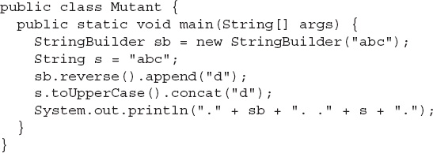
Popular Interview Questions
1. Given:

Slide 45
Popular Interview Questions
Which two substrings will be included in the result? (Choose two.)
A.abc.
B.ABCd.
C.ABCD.
D.cbad.
E.dcba.
Answer: A & D

Slide 46
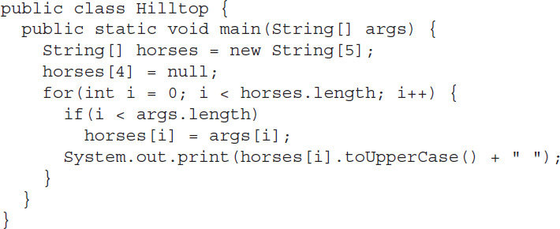
Popular Interview Questions
2. Given:

Slide 47
Popular Interview Questions
And, if the code compiles, the command line:
What is the result?
A. EYRA VAFI DRAUMUR KARA
B. EYRA VAFI DRAUMUR KARA null
C. An exception is thrown with no other output
D. EYRA VAFI DRAUMUR KARA, and then a NullPointerException
E. EYRA VAFI DRAUMUR KARA, and then an ArrayIndexOutOfBoundsException
F. Compilation fails
Answer: D

Slide 48
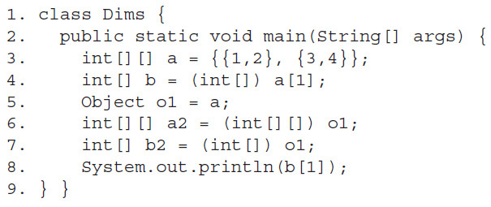
Popular Interview Questions
3. Given:

Slide 49
Popular Interview Questions
What is the result? (Choose all that apply.)
A. 2
B. 4
C. An exception is thrown at runtime
D. Compilation fails due to an error on line 4
E. Compilation fails due to an error on line 5
F. Compilation fails due to an error on line 6
G. Compilation fails due to an error on line 7
Answer: C

Slide 50
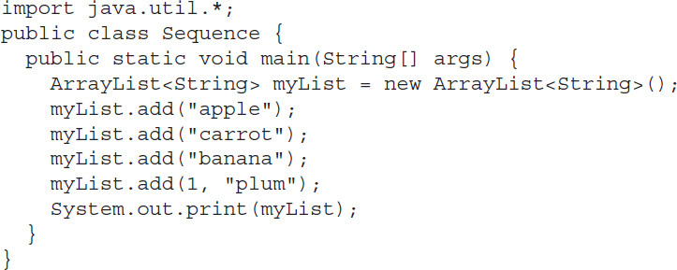
Popular Interview Questions
4. Given:

Slide 51
Popular Interview Questions
What is the result?
A. [apple, banana, carrot, plum]
B. [apple, plum, carrot, banana]
C. [apple, plum, banana, carrot]
D. [plum, banana, carrot, apple]
E. [plum, apple, carrot, banana]
F. [banana, plum, carrot, apple]
G. Compilation fails
Answer: B

Slide 52
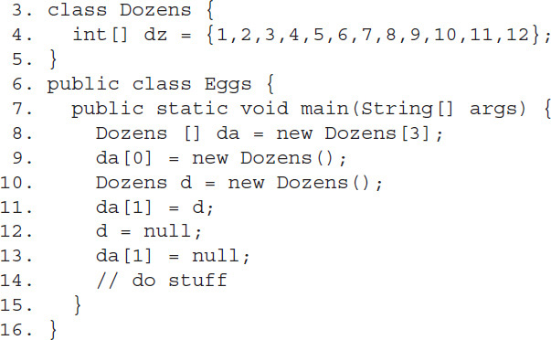
Popular Interview Questions
5. Given:

Slide 53
Popular Interview Questions
Which two are true about the objects created within main(), and
which are eligible for garbage collection when line 14 is
reached?
A. Three objects were created
B. Four objects were created
C. Five objects were created
D. Zero objects are eligible for GC
E. One object is eligible for GC
F. Two objects are eligible for GC
G. Three objects are eligible for GC
Answer: C & F

Slide 54
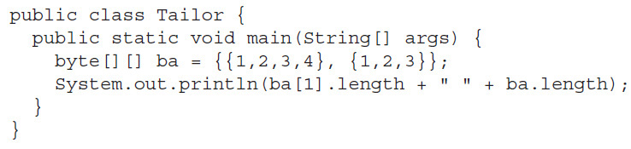
Popular Interview Questions
6. Given:

Slide 55
Popular Interview Questions
What is the result?
A. 2 4
B. 2 7
C. 3 2
D. 3 7
E. 4 2
F. 4 7
G. Compilation fails
Answer: C

Slide 56
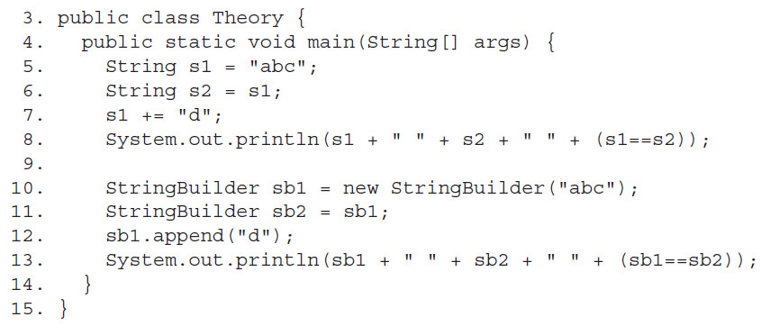
Popular Interview Questions
7. Given:

Slide 57
Popular Interview Questions
Which are true? (Choose all that apply.)
A. Compilation fails
B. The first line of output is abc abc true
C. The first line of output is abc abc false
D. The first line of output is abcd abc false
E. The second line of output is abcd abc false
F. The second line of output is abcd abcd true
G. The second line of output is abcd abcd false
Answer: D & F

Slide 58
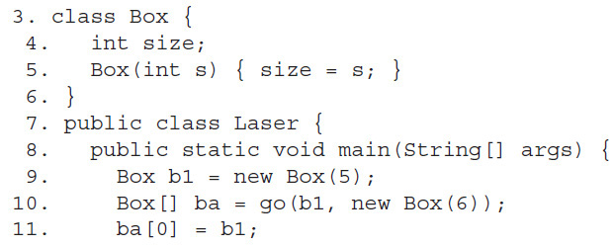
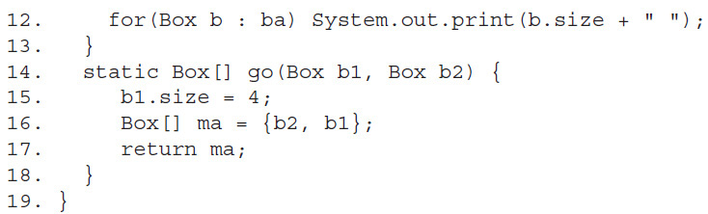
Popular Interview Questions
8. Given:

Slide 59
Popular Interview Questions
What is the result?
A. 4 4
B. 5 4
C. 6 4
D. 4 5
E. 5 5
F. Compilation fails
Answer: A

Slide 60
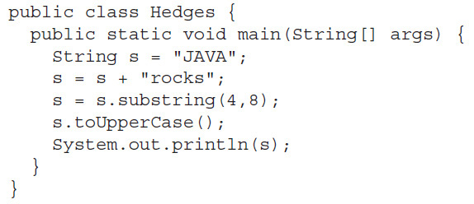
Popular Interview Questions
9. Given:

Slide 61
Popular Interview Questions
What is the result?
A. JAVA
B. JAVAROCKS
C. rocks
D. rock
E. ROCKS
F. ROCK
G. Compilation fails
Answer: D

Slide 62
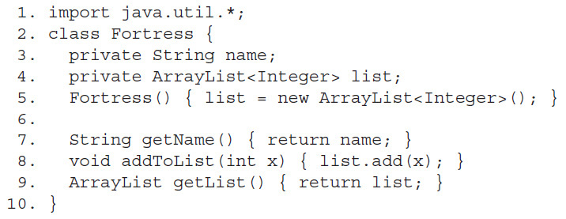
Popular Interview Questions
10. Given:

Slide 63
Popular Interview Questions
Which lines of code (if any) break encapsulation? (Choose all that apply.)
A. Line 3
B. Line 4
C. Line 5
D. Line 7
E. Line 8
F. Line 9
G. The class is already well encapsulated
Answer: F

Slide 64
Popular Interview Questions
11 .What is the output of the following code?
class Demo {
public static void main(String args[]) {
String ejg = "game".replace('a', 'Z').trim().concat("Aa");
ejg.substring(0, 2);
System.out.println(ejg); } }
A. gZmeAZ
B. gZmeAa
C. gZm
D. gZ
E .game
Answer: B

Slide 65
Popular Interview Questions
12 .What is the output of the following code?
class Demo {
public static void main(String args[]) {
StringBuilder ejg = new StringBuilder(10 + 2 + "SUN" + 4 + 5);
ejg.append(ejg.delete(3, 6)); System.out.println(ejg);
}
}
A.12S512S5
B.12S12S
C.1025102S
D. Runtime exception
Answer: A

Slide 66
Popular Interview Questions
13.What is the output of the following code?
class Demo {
public static void main(String args[]) {
int[] arr1;
int[] arr2 = new int[3];
char[] arr3 = {'a', 'b'};
arr1 = arr2; arr1 = arr3;
System.out.println(arr1[0] + ":" + arr1[1]); } }
A.0:0
B.a:b
C.0:b
D.a:0
E.Compilation error
Answer: E

Slide 67
Popular Interview Questions
14 .What is the output of the following code?
String input = "\tContango ";
System.out.println(input.trim().length());
A. 8
B. 9
C. 10
D. 11
Answer: A

Slide 68
Popular Interview Questions
15 .What is the output of the following code?
StringBuilder sb = new StringBuilder("Storage ");
sb.insert(0, "File");
sb.append("almost full");
System.out.print(sb);
A. File Storage almost full
B. FileStorage almost full
C. java.lang.StringBuilder
D. The fully-qualified class name for StringBuilder followed by a random string.
Answer: B

Slide 69
Popular Interview Questions
16 .What is the output of the following code?
StringBuffer sb1 = new StringBuffer("Hello");
StringBuffer sb2 =new StringBuffer("Hello");
System.out.println(sb1==sb2);
System.out.println(sb1.equals(sb2));
A. true true
B. false false
C. true false
D. false true
Answer: B

Slide 70
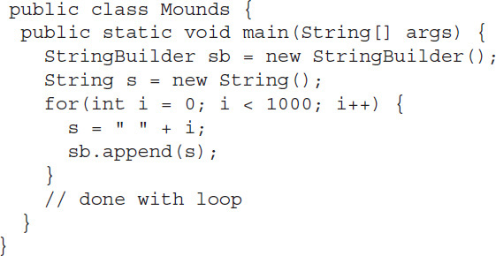
Popular Interview Questions
17. Given:

Slide 71
Popular Interview Questions
If the garbage collector does NOT run while this code is executing, approximately how many objects will exist in memory when the loop is done?
A. Less than 10
B. About 1000
C. About 2000
D. About 3000
E. About 4000
Answer: B

Slide 72
Popular Interview Questions
18 .What is the output of the following code?
String ceiling = "up";
String floor = new String("up");
String wall = new String(floor);
System.out.print((ceiling==wall) +" "+(floor==wall)+" "+ceiling.equals(wall));
A. false false true
B. true true false
C. true false false
D. false true true
Answer: A

Slide 73
Popular Interview Questions
19 .What is the output of the following code?
String s1 = "WOW“;
StringBuilder s2 = new StringBuilder(s1);
String s3 = new String(s2);
System.out.println((s1.hashCode() == s2.hashCode()) + " " + (s1.hashCode() == s3.hashCode()));
A. false false
B. true true
C. true false
D. false true
Answer: D

Slide 74
Popular Interview Questions
20 . Which statements about the following program are true?
public interface HeavenlyBody { String describe(); } class Star { String starName; public String describe() { return "star " + starName; } } class Planet extends Star { String name; public String describe() { return "planet " + name + " orbiting star " + starName; } }

Slide 75
Popular Interview Questions
Select the three correct answers:
A.The code will fail to compile.
B. The code defines a Planet is-a Star relationship.
C. The code will fail to compile if the name starName is replaced with the name bodyName throughout the declaration of the Star class.
D. The code will fail to compile if the name starName is replaced with the name name throughout the declaration of the Star class.
E. An instance of Planet is a valid instance of HeavenlyBody.
F. The code defines a Planet has-a Star relationship.
Answer: B,C,D

